Slide 1
ClauseIQ
Machine Learning-Based Contract Clause Classification
& Intelligent Search System
DEVELOPED BY:
Mohammed Farhan K | Reg No: MAC25MCA-2042
Department of Computer Applications
PROJECT GUIDE:
Dr. Sonia Abraham | Associate Professor, Dept. of Computer Applications
Mar Athanasius College of Engineering, Kothamangalam | August 2026
Notes:
Good morning everyone. I am Mohammed Farhan K, a student of the MCA Department at Mar Athanasius College of Engineering. Today, I am presenting the first stage of my Mini Project titled 'ClauseIQ -- Machine Learning-Based Contract Clause Classification and Intelligent Search System'. This project is supervised by my guide, Dr. Sonia Abraham. This presentation will cover the problem statement, objectives, literature review, dataset analysis, exploratory data analysis, preprocessing, chosen machine learning algorithms, flowcharts, pseudocodes, system architecture, and our proposed GUI design.

Slide 2
PROBLEM STATEMENT
Challenges in Traditional Legal Document Processing
1. Review Fatigue
• Thousands of legal contracts.
• Manual review is slow.
• Fatigue causes risk omissions.
2. No Semantic Search
• Keyword searches are literal.
• Synonyms are entirely missed.
• Fails on terminology changes.
3. High Review Costs
• Agreements are unstructured.
• Key clauses are buried.
• High due diligence costs.
ClauseIQ -- Machine Learning-Based Contract Clause Classification and Intelligent Search
Dept. of Computer Applications, MACE | Slide 2
Notes:
Let's look at the core problem. Commercial organizations deal with a massive volume of active legal contracts. Manual analysis of these documents is slow and prone to cognitive errors, potentially exposing companies to compliance risks. Standard keyword search is literal and doesn't capture semantics. A query for 'Liability Limit' will miss clauses that refer to 'aggregate exposure limit' or 'indemnity cap'. Contracts also lack a standardized structure. This creates high operational costs and delays. ClauseIQ addresses this by automating clause classification and similarity-based retrieval.

Slide 3
PROJECT OBJECTIVES
Engineering Goals of the ClauseIQ Pipeline
Functional Deliverables
• Extract text via PyMuPDF.
• Segment text into clauses.
• Categorize into 41 legal classes.
• Implement concept-aware search.
• Compare four ML classifiers.
• Expose professional GUI dashboard.
Architecture Focus
Lightweight Classical ML Pipeline:
• Deterministic outputs.
• Zero hallucination risk.
• Local CPU deployment.
• Safe for private legal data.
ClauseIQ -- Machine Learning-Based Contract Clause Classification and Intelligent Search
Dept. of Computer Applications, MACE | Slide 3
Notes:
Our project has six key engineering objectives: First, parse and extract text from PDFs. Second, segment unstructured text into clauses. Third, classify clauses automatically into 41 predefined CUAD categories. Fourth, implement a similarity-based search engine. Fifth, evaluate and compare four classical ML algorithms. Sixth, build a clean dashboard interface. We emphasize lightweight, deterministic local processing to preserve privacy, eliminate hallucination risks, and keep the application computationally lightweight, fitting within the MCA Mini Project scope.

Slide 4
LITERATURE REVIEW
Comparison of Supporting IEEE Publications
Paper (Year) | Methodology | Key Advantage | Limitations | Relation to ClauseIQ
Quevedo (2024) | Mapping study of 75 papers. | Maps Legal NLP trends and resources. | Review only; no implementation. | Validates clause categorization tasks.
Siino (2025) | Survey of 61 legal LLM models. | Identifies LLM task improvements. | Highlights hallucination risk & cost. | Justifies choice of classical ML baseline.
Kutbi (2023) | spaCy NER pre-processor. | Entity replacement preserves privacy. | Requires pre-trained NER models. | Validates text cleaning protocols.
RESEARCH GAP:
• Current papers focus on heavy LLMs that are expensive and prone to hallucination.
• Lack of lightweight, explainable, and local tools for clause classification.
ClauseIQ -- Machine Learning-Based Contract Clause Classification and Intelligent Search
Dept. of Computer Applications, MACE | Slide 4
Notes:
Our literature review covers three recent IEEE papers. Quevedo et al. (2024) provide a mapping study that validates contract clause classification as a core Legal NLP task. Siino et al. (2025) review LLM applications in law, highlighting risks like hallucinations, privacy, and compute costs, which justifies our choice of deterministic classical ML. Kutbi (2023) shows that replacing named entities with generic tokens in preprocessing increases classification accuracy and preserves privacy. The research gap is the lack of lightweight, explainable, local systems, which ClauseIQ addresses.

Slide 5
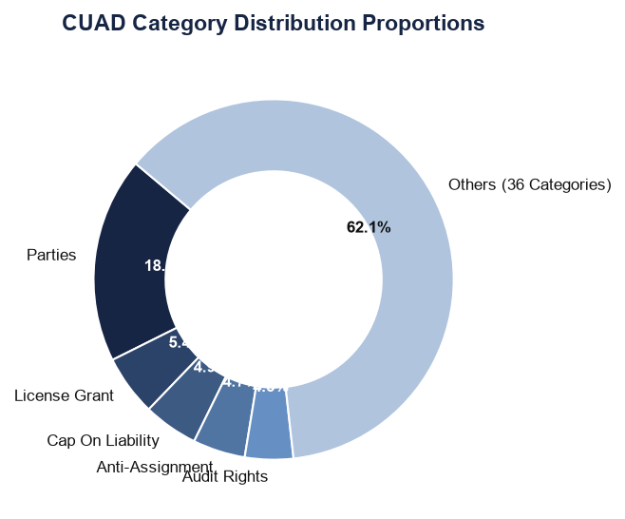
DATASET ANALYSIS
CUAD: Contract Understanding Atticus Dataset
Dataset Properties
• 510 commercial contracts.
• SEC EDGAR source database.
• 41 distinct legal categories.
• 13,000+ annotated clauses.
• Flattened to clause-level CSV.
ClauseIQ -- Machine Learning-Based Contract Clause Classification and Intelligent Search
Dept. of Computer Applications, MACE | Slide 5
Notes:
For dataset analysis, we utilize the Contract Understanding Atticus Dataset (CUAD), which is a public, expert-annotated legal NLP benchmark. It consists of 510 real commercial contracts from the SEC EDGAR database, with over 13,000 manually annotated clause spans across 41 categories. We flattened this QA dataset into a structured CSV, yielding 13,823 clauses. The pie chart on the right displays the class distribution. We notice a strong imbalance: the largest class 'Parties' accounts for 18.5% of the dataset, which requires class-balancing strategies.

Slide 6
EXPLORATORY DATA ANALYSIS
Statistical Profiling and Pandas Methods
Metadata & Distribution
• Data shape: 13,823 rows, 5 columns.
• Missing values: 0 across all columns.
• Duplicate text spans: 0 duplicates.
• Skewed word lengths:
• Mean: 40.7, Median: 31 words.
• Tail stretches up to 479 words.
Statistical Operations
• info(): Verify non-null types.
• describe(): Length statistics.
• value_counts(): Category imbalance.
• head() / tail(): Inspect structure.
Requires length-normalized TF-IDF and stratified dataset splits.
ClauseIQ -- Machine Learning-Based Contract Clause Classification and Intelligent Search
Dept. of Computer Applications, MACE | Slide 6
Notes:
For Exploratory Data Analysis, we profile the dataset using Pandas. The dataset contains 13,823 rows and 5 columns. We used shape to verify size, info() to confirm that there are zero missing values, and describe() to analyze clause lengths. The mean word count is 40.7, but the median is 31, with a long tail up to 479 words. This right-skewed distribution justifies length-normalized TF-IDF vectorization. We also used value_counts() to profile the 41 categories, showing a severe class imbalance ranging from 2,554 'Parties' samples down to 27 'Price Restrictions' samples, which necessitates a stratified train-test split.

Slide 7
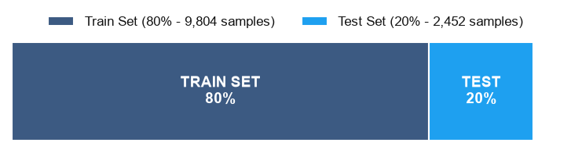
DATA PREPROCESSING PIPELINE
Feature Engineering and Dataset Split
Raw Text
Cleaning
Tokenize
Lemmatize
TF-IDF Vector
Features
Text Preprocessing
• Normalization: Lowercase & clean.
• Short Filter: Drop spans < 3 words.
• spaCy: Lemmatization & tokenizing.
• Stopwords: Eliminate noise words.
Feature & Split
• TF-IDF features (max=5000).
• (1,2)-grams capture bigram context.
• Stratified 80:20 split ratio.
• Class-weights handle imbalance.
ClauseIQ -- Machine Learning-Based Contract Clause Classification and Intelligent Search
Dept. of Computer Applications, MACE | Slide 7
Notes:
This flowchart outlines our data preprocessing steps. The raw text goes through text cleaning (case normalisation and noise stripping), short-span filtering, tokenization, and lemmatization using spaCy. We then convert the text to numerical features using TF-IDF. We extract unigrams and bigrams, cap the vocabulary at 5,000 terms, and use L2 normalization to handle variable clause lengths. Finally, we split the corpus into an 80% training set and a 20% test set. We use a stratified split to ensure that all 41 categories, even the rarest ones, are represented proportionally in both sets.

Slide 8
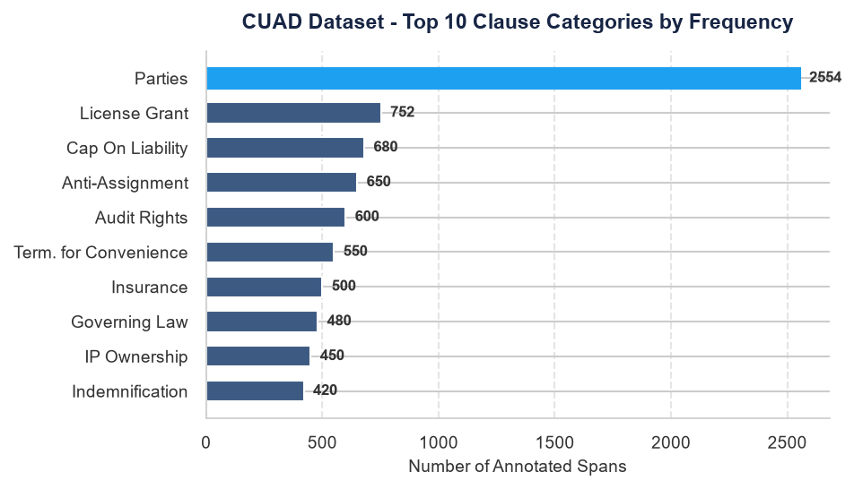
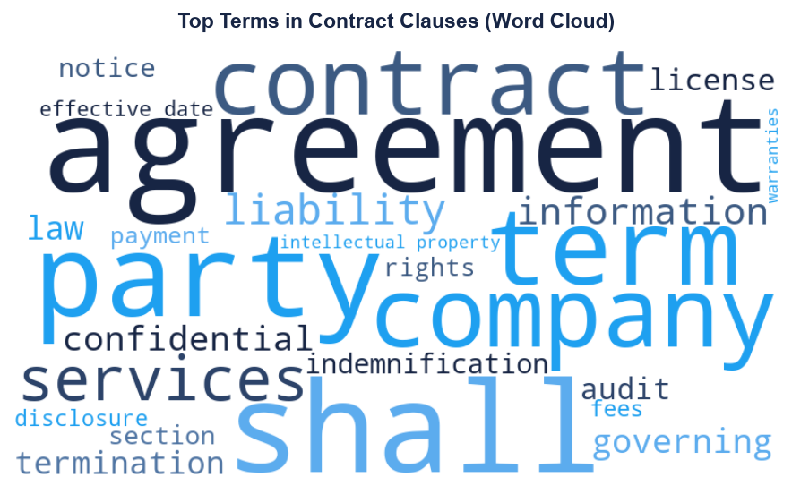
DATA VISUALIZATION ANALYSIS
Exploratory Charts of the Clause Corpus
• Bar Chart shows severe class imbalance, requiring macro-F1.
• Word Cloud displays legal vocab, validating stopword removal.
ClauseIQ -- Machine Learning-Based Contract Clause Classification and Intelligent Search
Dept. of Computer Applications, MACE | Slide 8
Notes:
This slide presents the results of our data visualization analysis. On the left, the horizontal bar chart illustrates the top 10 categories, highlighting the strong class imbalance, with 'Parties' being the dominant class. On the right, the Word Cloud shows the most common terms in the contracts. We see high frequencies of boilerplate legal terms like 'shall', 'agreement', 'party', 'confidential', and 'liability'. This visualizes why unigrams alone are insufficient and bigrams are needed to capture category-specific context. These charts were generated using Matplotlib, Seaborn, and the WordCloud libraries.

Slide 9
MACHINE LEARNING ALGORITHMS
Working Principles and Selections for Classification
Algorithm | Working Principle | Key Advantage | Key Disadvantage
Logistic Regression | Multiclass Softmax boundary | Outputs probability scores | Assumes linear boundary
Support Vector Machine | Linear Kernel hyperplane margin | Excellent for high-dim text | High training complexity
Multinomial Naive Bayes | Bayesian conditional probability | Extremely fast baseline | Assumes independent terms
Random Forest | Ensemble of Decision Trees | Captures non-linear features | Slow training, large size
ClauseIQ -- Machine Learning-Based Contract Clause Classification and Intelligent Search
Dept. of Computer Applications, MACE | Slide 9
Notes:
We select four classical machine learning algorithms. Multinomial Naive Bayes serves as our simple baseline. Linear SVM is chosen because text classification problems are often linearly separable in high-dimensional spaces, and SVMs handle sparse TF-IDF vectors exceptionally well. Logistic Regression provides class probability distributions, which is useful for indicating prediction confidence to the user. Random Forest is selected as an ensemble method to capture non-linear interactions between terms.

Slide 10
ALGORITHMIC COMPARISON STRATEGY
Parameters and Selection Rationale
Algorithm | Train Speed | Accuracy | Memory | Best Use Case
Naive Bayes | Very Fast | Moderate | Very Low | Fast Baseline
Linear SVM | Moderate | Very High | Low | High-Dim Text
Logistic Regression | Fast | High | Low | Explainable Classifier
Random Forest | Slow | High | High | Ensemble Baseline
• Justification: Text is often linearly separable; linear models (SVM, LR) perform best.
• Comparison evaluates optimal model trade-off for lightweight, local deployment.
ClauseIQ -- Machine Learning-Based Contract Clause Classification and Intelligent Search
Dept. of Computer Applications, MACE | Slide 10
Notes:
This comparison grid highlights the trade-offs of each model. While Random Forest is robust, it has a larger memory footprint and slower training speeds. Linear SVM and Logistic Regression are computationally efficient and perform exceptionally well on sparse, high-dimensional TF-IDF matrices. Comparing multiple classifiers allows us to empirically determine the optimal balance of accuracy, memory footprint, and inference speed, ensuring that ClauseIQ remains explainable and lightweight for local desktop deployment.

Slide 11
SYSTEM FLOWCHART
Functional Diagram of Pipeline Execution
ML Classifier
Clause
Class
PDF Upload
Text Extract
Segmenting
Cleaning
TF-IDF features
Search Engine
Ranked
Output
• Ingestion: Extracts raw contract text from PDF using PyMuPDF.
• Processing: Cleaned clauses are TF-IDF vectorized for parallel ML Classification and Cosine Similarity Search.
ClauseIQ -- Machine Learning-Based Contract Clause Classification and Intelligent Search
Dept. of Computer Applications, MACE | Slide 11
Notes:
This slide displays the system flowchart. The process starts when the user uploads a contract. PyMuPDF extracts the raw text. Next, the text is segmented into distinct clauses and cleaned. We transform the cleaned text into numerical features using TF-IDF. This vectors are sent to two modules: the ML Classifier (predicts the category and outputs confidence scores) and the Search Engine (compares queries using Cosine Similarity and displays ranked results).

Slide 12
SYSTEM PSEUDOCODE
Algorithmic Control Flow
START ClauseIQ_Pipeline:
1. Ingest PDF document from frontend upload widget
2. Extract raw string: raw_text = PyMuPDF.extract_text(PDF)
3. Segment text: clauses = split_into_paragraphs(raw_text)
4. Preprocess: clean_clauses = [clean(c) for c in clauses if len(words) >= 3]
5. Vectorize: corpus_vectors = tfidf_vectorizer.transform(clean_clauses)
6. Classify:
predicted_category = trained_model.predict(corpus_vectors)
confidence = trained_model.predict_proba(corpus_vectors).max()
7. Search query: query_vector = tfidf_vectorizer.transform([user_query])
ranked_results = cosine_similarity(query_vector, corpus_vectors).sort_desc()
END ClauseIQ_Pipeline
ClauseIQ -- Machine Learning-Based Contract Clause Classification and Intelligent Search
Dept. of Computer Applications, MACE | Slide 12
Notes:
This pseudocode details the algorithmic flow. When a PDF is uploaded, PyMuPDF extracts the raw text. The text is segmented into distinct clauses, and short paragraphs are filtered out. We then extract features using TF-IDF. The classifier predicts the category and calculates the confidence score. Finally, if the user submits a search query, it is vectorized and ranked against the corpus using Cosine Similarity, displaying the results in the table.

Slide 13
PROJECT PIPELINE
Linear Architectures Components Workflow
Step 01
User
Step 02
React UI
Step 03
Flask API
Step 04
PyMuPDF
Step 05
ML Model
Step 06
Similarity
Step 07
Results UI
• React UI sends documents and queries to Flask backend.
• Python code extracts paragraphs, tokenizes, and lemmatizes text.
• Scikit-learn classifies text and calculates Cosine Similarity rankings.
ClauseIQ -- Machine Learning-Based Contract Clause Classification and Intelligent Search
Dept. of Computer Applications, MACE | Slide 13
Notes:
This project pipeline displays our linear component workflow. The user interacts with the React frontend to upload PDFs. The frontend sends requests to our Flask backend via RESTful APIs. The backend processes the document using PyMuPDF, converts the clauses to TF-IDF vectors, performs machine learning predictions, and executes search rankings. The results are stored in SQLite and returned as JSON data to render in the user interface.

Slide 14
SYSTEM ARCHITECTURE
Interaction Layers and Data Boundaries
Client Layer
React.js SPA Dashboard
• File upload widget.
• Search query bar.
• Clause interactive log.
Logic Layer
Flask Server (Python)
• PyMuPDF text parser.
• spaCy preprocessing.
• Scikit-learn ML models.
• Cosine Sim engine.
Data Layer
SQLite Database
• Extracted text strings.
• Predicted legal classes.
• Model confidence scores.
ClauseIQ -- Machine Learning-Based Contract Clause Classification and Intelligent Search
Dept. of Computer Applications, MACE | Slide 14
Notes:
The system architecture is structured into three layers: First, the Client Layer built with React.js, which manages user interaction. Second, the Logic Layer implemented as a Flask API in Python, which handles PDF parsing, text preprocessing, model prediction, and cosine-similarity calculations. Third, the Data Layer utilizing SQLite to store extracted text segments, prediction metadata, and confidence scores. This self-contained structure allows offline, local deployment.

Slide 15
GUI DESIGN MOCKUP
Proposed Deployable Dashboard Layout
ClauseIQ Dashboard -- Contract Analysis & Semantic Search
MENU
[+] Upload PDF
[o] View Clauses
[?] Query Search
[*] Model Stats
[x] Settings
Upload Contract PDF
[ Drag & Drop PDF Here ]
- File: .pdf Format
Intelligent Semantic Search
Query: [ Find governing law and liability caps... ]
Extracted Clauses & Predictions Log
Clause Snippet | Predicted Class | Conf. | Action
"This Agreement governed by NY law..." | Governing Law | 98.4% | [View]
"In no event shall liability exceed $50k..."| Cap On Liability | 95.8% | [View]
"Neither party may assign rights..." | Anti-Assignment | 91.2% | [View]
ClauseIQ -- Machine Learning-Based Contract Clause Classification and Intelligent Search
Dept. of Computer Applications, MACE | Slide 15
Notes:
This slide displays a visual mockup of our proposed user interface, built directly with shapes. The layout consists of a dark blue top header bar, a slate blue left sidebar for navigation, and a main area split into cards. The left card contains a drag-and-drop file upload zone. The right card contains the similarity search engine bar. At the bottom, the results table displays the extracted clause texts, predicted categories, confidence scores, and action buttons.

Slide 16
SCREEN DETAILS
Functional GUI Components and User Actions
1. Upload PDF Box
• Accepts standard PDF contracts.
• Ingests text for segmentation.
2. Search Bar
• Vectorizes search query texts.
• Runs Cosine Similarity matching.
3. Clause Viewer
• Displays parsed paragraph list.
• Shows predicted legal labels.
4. Category Filter
• Isolates specific categories.
• Enables rapid compliance triage.
5. Prediction Tag
• Shows labels & confidence.
• Flags low confidence predictions.
ClauseIQ -- Machine Learning-Based Contract Clause Classification and Intelligent Search
Dept. of Computer Applications, MACE | Slide 16
Notes:
This slide details the functionality of the GUI components: The Upload PDF button ingests documents. The Search Box parses natural language queries and runs Cosine Similarity to surface relevant clauses. The Clause Viewer displays text snippets with their predicted categories. The Category Filter helps legal professionals filter the table to specific topics, and the Prediction Result Card displays the predicted labels and confidence scores, flagging low-confidence values.

Slide 17
TOOLS & TECHNOLOGIES
System Development Stack
Languages & Web
• Python (Core Logic)
• Flask (REST APIs)
• HTML & CSS
• JavaScript
Data & ML Stack
• Scikit-learn (ML & TF-IDF)
• spaCy (NLP Preprocessing)
• NLTK
• Pandas & NumPy
Utilities & DB
• SQLite (Database)
• PyMuPDF (PDF Parser)
• Matplotlib & Seaborn
• WordCloud
ClauseIQ -- Machine Learning-Based Contract Clause Classification and Intelligent Search
Dept. of Computer Applications, MACE | Slide 17
Notes:
This slide outlines our system stack: Python is the core language. We use Flask for the backend, HTML, CSS, and JS for frontend layouts, and SQLite for self-contained relational storage. For machine learning, we use Scikit-learn to handle training, classification, and TF-IDF extraction, spaCy and NLTK for preprocessing, and PyMuPDF to extract text from PDFs. Matplotlib, Seaborn, and WordCloud are used to generate visual summaries.

Slide 18
EXPECTED OUTPUT
Sample System Output Logs and Search Relevance
Contract | Extracted Clause Snippet | Predicted Class | Confidence | Cosine (Query)
NDA_2026.pdf | "This Agreement shall be governed by, and construed in accordance with, the laws of the State of New York..." | Governing Law | 98.4% | 0.91 ('state law')
SLA_Service.pdf | "In no event shall either party's aggregate liability under this agreement exceed fifty thousand dollars..." | Cap On Liability | 95.8% | 0.85 ('liability limit')
Lease_Final.pdf | "Tenant shall not assign this Lease or sublet the premises without obtaining landlord's prior written consent..." | Anti-Assignment | 91.2% | 0.78 ('transfer lease')
• Automatic Categorization: Identifies legal labels and predicts class probabilities.
• Concept-Aware Matching: Retrieves clauses by semantics (e.g. 'liability limit' matched 'aggregate liability exceed').
ClauseIQ -- Machine Learning-Based Contract Clause Classification and Intelligent Search
Dept. of Computer Applications, MACE | Slide 18
Notes:
This slide showcases the expected system output. When a contract PDF is uploaded, the system segments the text, predicts its legal category, and displays the classifier's confidence score. If the user searches for a query like 'liability limit', the system matches clauses like 'aggregate liability exceed $50,000' using Cosine Similarity, even though they don't share identical literal keywords.

Slide 19
FUTURE ENHANCEMENTS
ClauseIQ Development Roadmap
Future Scopes
• LLM Integration: Test zero-shot legal classification in next main projects.
• RAG Pipeline: Connect clauses index to generative models for compliance audits.
• Multilingual Models: Classify contracts in translation layers (French, Spanish).
• Cloud Deployment: Migrate to FastAPI / Supabase hosted on cloud server (AWS).
• Automated Summarization: Generate bulleted contract executive summaries.
• Interactive Legal Chatbot: Chat with agreements via retrieved context answers.
ClauseIQ -- Machine Learning-Based Contract Clause Classification and Intelligent Search
Dept. of Computer Applications, MACE | Slide 19
Notes:
Looking ahead, we have defined several enhancements for our fourth-semester main project. First, we will evaluate lightweight LLMs and deep learning models (e.g. Legal-BERT) to handle complex zero-shot classification tasks. Second, we plan to implement Retrieval-Augmented Generation (RAG) to allow conversational queries over the clause database. Third, we will extend the system with multilingual support, automatic summarization, and cloud deployment on AWS.

Slide 20
THANK YOU
ClauseIQ: Contract Clause Classification & Intelligent Search System
Student Name: Mohammed Farhan K | Reg No: MAC25MCA-2042
Project Guide: Dr. Sonia Abraham
Department of Computer Applications
Mar Athanasius College of Engineering, Kothamangalam
Contact: farhank@mace.ac.in | Questions & Discussion
Notes:
Thank you very much for your time and attention. I am now open to your questions, feedback, and suggestions.

